Slide 1
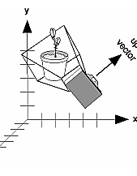
OpenGL Inputs and Camera
Mark Daniel Dacer

Slide 2
GLUT Callbacks
GLUT provides two functions to register callbacks for keyboard events that occur when you press a key. The first one, glutKeyboardFunc, is used to tell the windows system which function we want to process the “normal” key events. By “normal” keys, we mean letters, numbers, anything that has an ASCII code. The syntax for this function is as follows:
void glutKeyboardFunc(void (*func) (unsigned char key, int x, int y));
void glutSpecialFunc(void (*func) (int key, int x, int y));

Slide 3
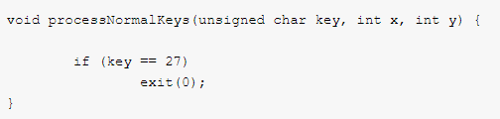
glutKeyboardFunc
Parameters:
func – The name of the function that will process the “normal” keyboard events. Passing NULL as an argument causes GLUT to ignore “normal” keys.
The function used as an argument to glutKeyboardFunc needs to have three arguments. The first provides the ASCII code of the key pressed, the remaining two arguments provide the mouse position when the key is pressed. The mouse position is relative to the top left corner of then client area of the window.

Slide 4
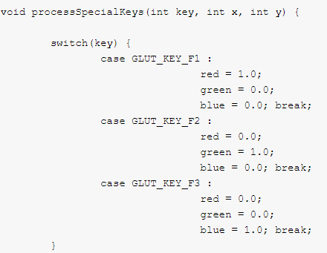
glutSpecialFunc
GLUT provides the function glutSpecialFunc so that you can register your function for special key event processing. The syntax for this function is as follows:
Parameters:
func – The name of the function that will process the special keyboard events. Passing NULL as an argument causes GLUT to ignore the special keys.

Slide 5
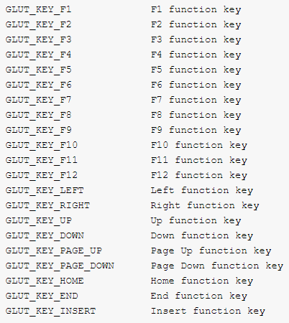
GLUT_KEY
GLUT_KEY are predefined constants in glut.h. The full set of constants is presented next:

Slide 6
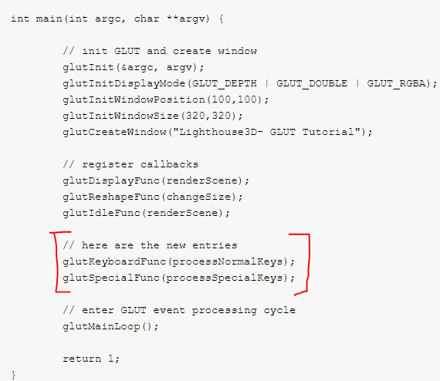
The call to these functions can be made anywhere, meaning that we may change the processing function for keyboard event processing at any time. However this is not an usual feature, so we’ll place it on the main function. Next we present the new main function, with keyboard processing is presented

Slide 7

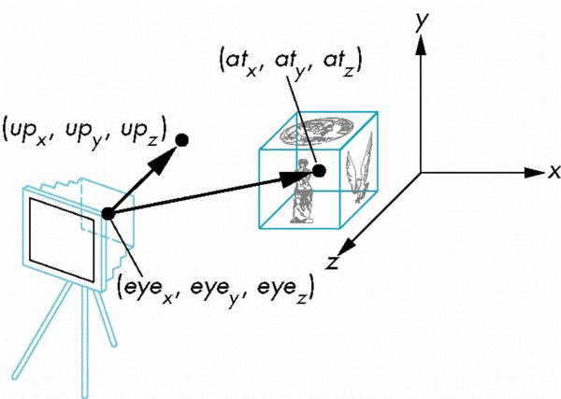
The LookAt Function
The GLU library contains the function gluLookAt to form the required modelview matrix through a simple interface
let's you specify location of viewpoint, a reference point toward which a camera is aimed, and which direction is up.
glLookAt(eyex, eyey, eyez, atx, aty, atz, upx, upy, upz)

Slide 8
Additional Links
OpenGL Viewing
https://cs.brynmawr.edu/Courses/cs312/fall2010/lectures/gl_04.pdf
OpenGL Inputs
https://www.lighthouse3d.com/tutorials/glut-tutorial/keyboard/

